Slide 1

Project 2 COVID-19 and its economic impact on oil and cryptocurrency
Abelardo
Mauricio
Luis
paulo

Slide 2

About
Our project seeks to find a relationship between the spread of the recent Coronavirus pandemic and the impact it has caused econimically speaking on certain financial instruments on the global stage. We will specficially be working with the prices of oil and cryptocurrencies: Bitcoin and Etherium.

Slide 3


Data
We obtained our data from the following sources:

Slide 4
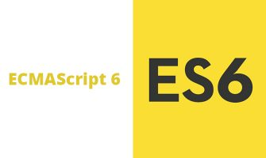
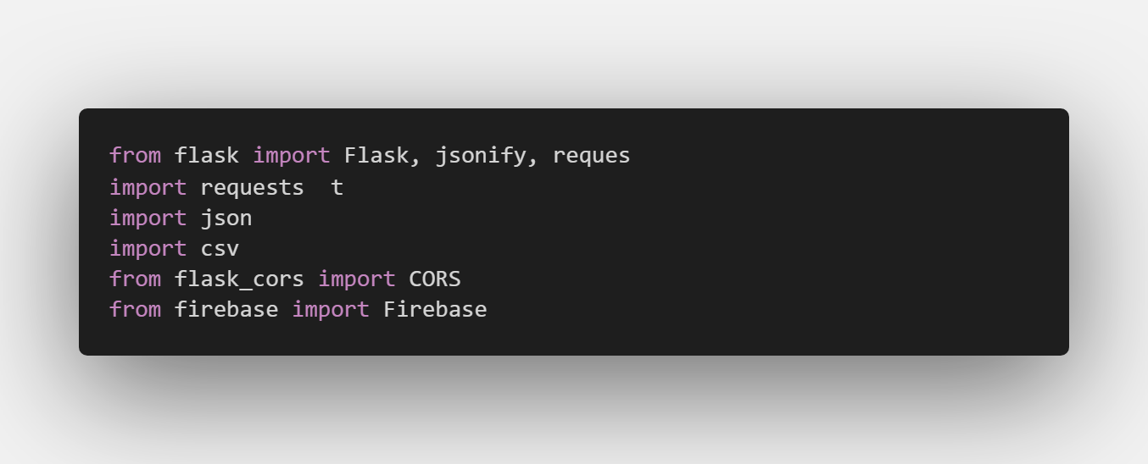

Code
Backend
Frontend

Slide 5
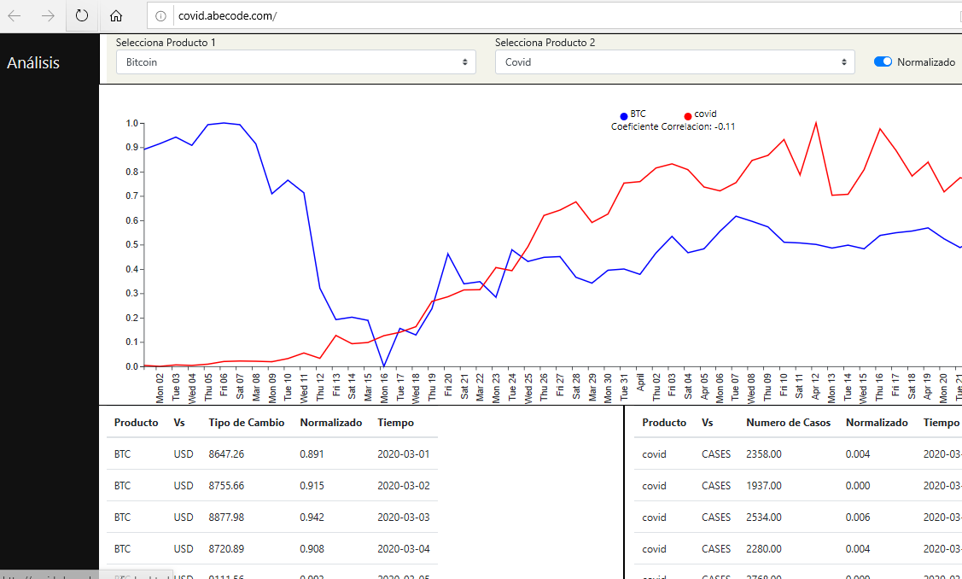
App
Link:
http://covid.abecode.com/

